Slide 1
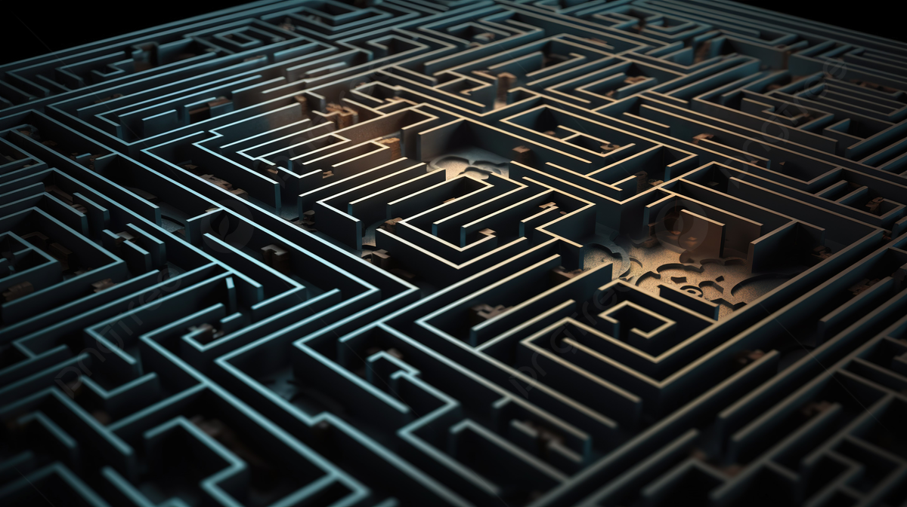
ENTANGLED
How To come out of the Labyrinth?

Slide 2
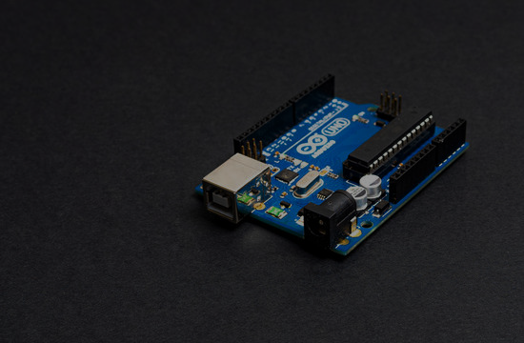
ARDUINO UNO
Arduino Uno: The Heart Of Our Robot
The most common development board for starters
Microcontroller: Atmega328P
Digital I/O Pins: 14 (6 PWM outputs)
Analog Input Pins: 6
Flash Memory: 32 KB (0.5 KB used by bootloader)
SRAM: 2 KB
Clock Speed: 16 MHz
USB interface for programming and communication
Power supply options: USB or External DC
Easy to use IDE (Integrated Development Environment)
Open-source hardware and software ecosystem
ARDUINO UNO

Slide 3

ARDUINO UNO
Arduino Uno: The Heart Of Our Robot
The most common development board for starters
Microcontroller: Atmega328P
Digital I/O Pins: 14 (6 PWM outputs)
Analog Input Pins: 6
Flash Memory: 32 KB (0.5 KB used by bootloader)
SRAM: 2 KB
Clock Speed: 16 MHz
USB interface for programming and communication
Power supply options: USB or External DC
Easy to use IDE (Integrated Development Environment)
Open-source hardware and software ecosystem
ARDUINO UNO

Slide 4
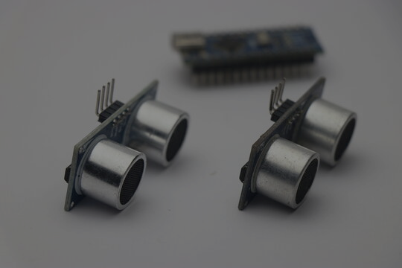
HC SR04
HC SR04- The Ultrasonic Sensor
Ultrasonic distance sensor
Operating voltage: 5V DC
Detection range: 2cm to 400cm
Accuracy: ±3mm
Trigger input and echo output pins for control
Simple interfacing with microcontrollers like Arduino
Non-contact measurement principle using ultrasonic waves
Widely used in robotics, automation, and proximity sensing applications

Slide 5
HC SR04
HC SR04- The Ultrasonic Sensor
Ultrasonic distance sensor
Operating voltage: 5V DC
Detection range: 2cm to 400cm
Accuracy: ±3mm
Trigger input and echo output pins for control
Simple interfacing with microcontrollers like Arduino
Non-contact measurement principle using ultrasonic waves
Widely used in robotics, automation, and proximity sensing applications

Slide 6
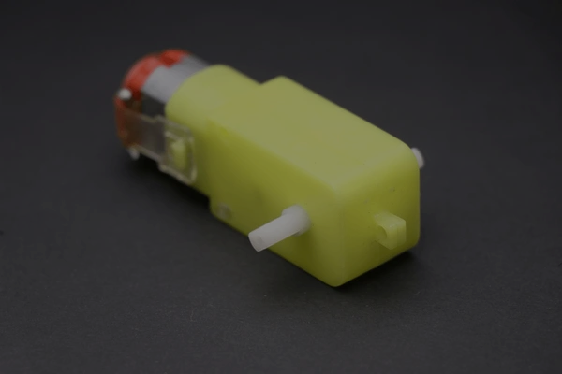
BO Motor
BO Motor: The Conveyer
BO (Brushed DC) motor
Consists of two terminals for power supply
Simple construction with a rotor and a permanent magnet stator
Direction of rotation can be controlled by reversing polarity
Commonly used in robotics and small-scale mechanical applications
Torque and speed depend on voltage and current supplied
Requires motor driver circuitry to interface with microcontrollers
Available in various sizes and torque ratings
Relatively low-cost and widely available
Can be used in pairs for differential drive systems

Slide 7
BO Motor
BO Motor: The Conveyer
BO (Brushed DC) motor
Consists of two terminals for power supply
Simple construction with a rotor and a permanent magnet stator
Direction of rotation can be controlled by reversing polarity
Commonly used in robotics and small-scale mechanical applications
Torque and speed depend on voltage and current supplied
Requires motor driver circuitry to interface with microcontrollers
Available in various sizes and torque ratings
Relatively low-cost and widely available
Can be used in pairs for differential drive systems

Slide 8
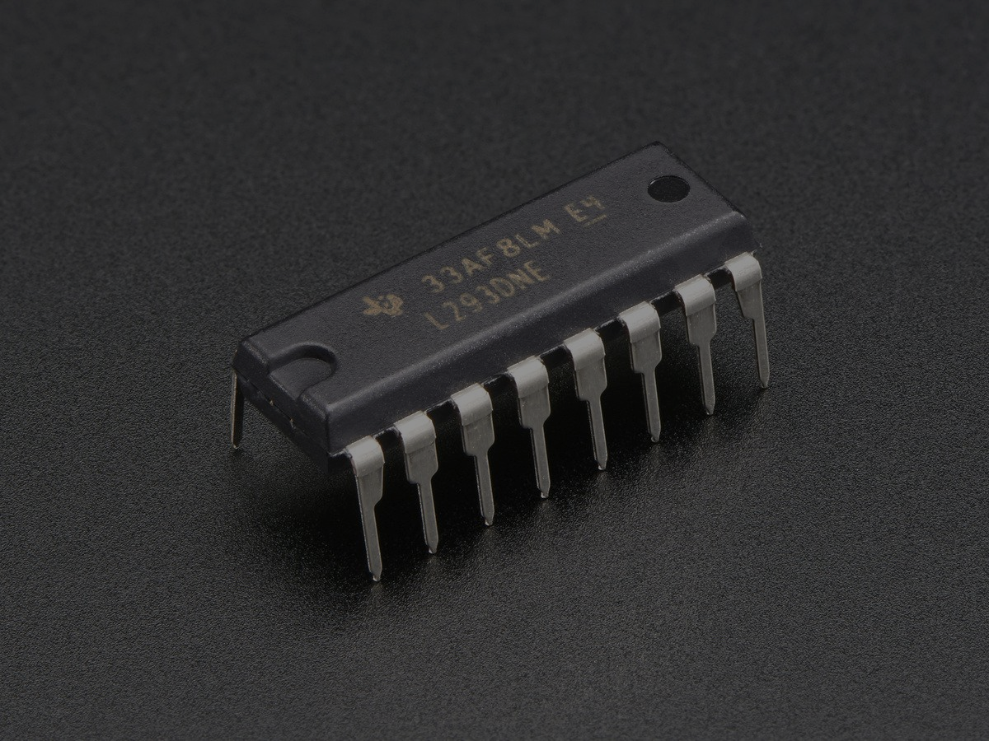
L293D: Motor Driver IC
L293D: H-bridge Motor Driver
L293D is a quadruple high-current half-H driver IC.
Designed to control inductive loads such as DC motors and stepper motors.
Can drive up to two DC motors bidirectionally or one stepper motor.
Operating voltage range typically from 4.5V to 36V.
Maximum continuous output current per channel: 600mA.
Peak output current per channel: 1.2A.
Contains built-in diodes for protection against back EMF (Electromotive Force) from inductive loads.
Requires external control signals to determine motor direction and speed.
Internal thermal shutdown and overload protection mechanisms.
Widely used in robotics, automation, and motor control projects.
Available in various package types including DIP and SOIC.

Slide 9
L293D: Motor Driver IC
L293D: H-bridge Motor Driver
L293D is a quadruple high-current half-H driver IC.
Designed to control inductive loads such as DC motors and stepper motors.
Can drive up to two DC motors bidirectionally or one stepper motor.
Operating voltage range typically from 4.5V to 36V.
Maximum continuous output current per channel: 600mA.
Peak output current per channel: 1.2A.
Contains built-in diodes for protection against back EMF (Electromotive Force) from inductive loads.
Requires external control signals to determine motor direction and speed.
Internal thermal shutdown and overload protection mechanisms.
Widely used in robotics, automation, and motor control projects.
Available in various package types including DIP and SOIC.

Slide 10
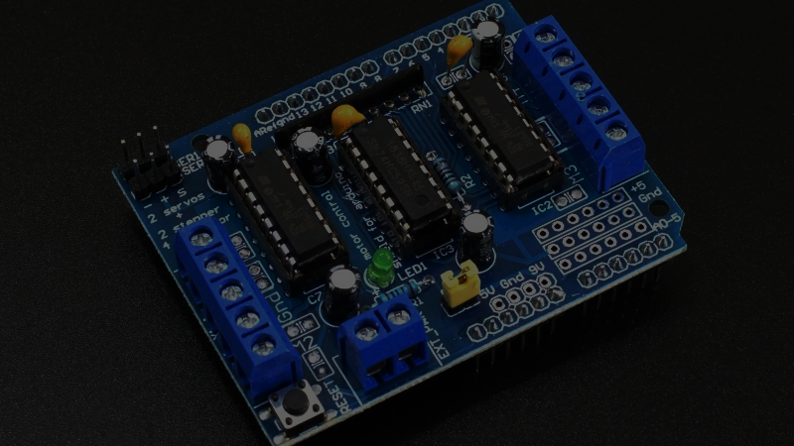
Why Use L293D Shield?
Simplifies motor control with Arduino
Handles high currents (up to 600mA per channel)
Enables bidirectional control of two DC motors or one stepper motor
Built-in diodes for protection against back EMF
Reduces need for external components
Compatible with popular development boards like Arduino

Slide 11
Let’s Jump Into The Coding

Slide 12
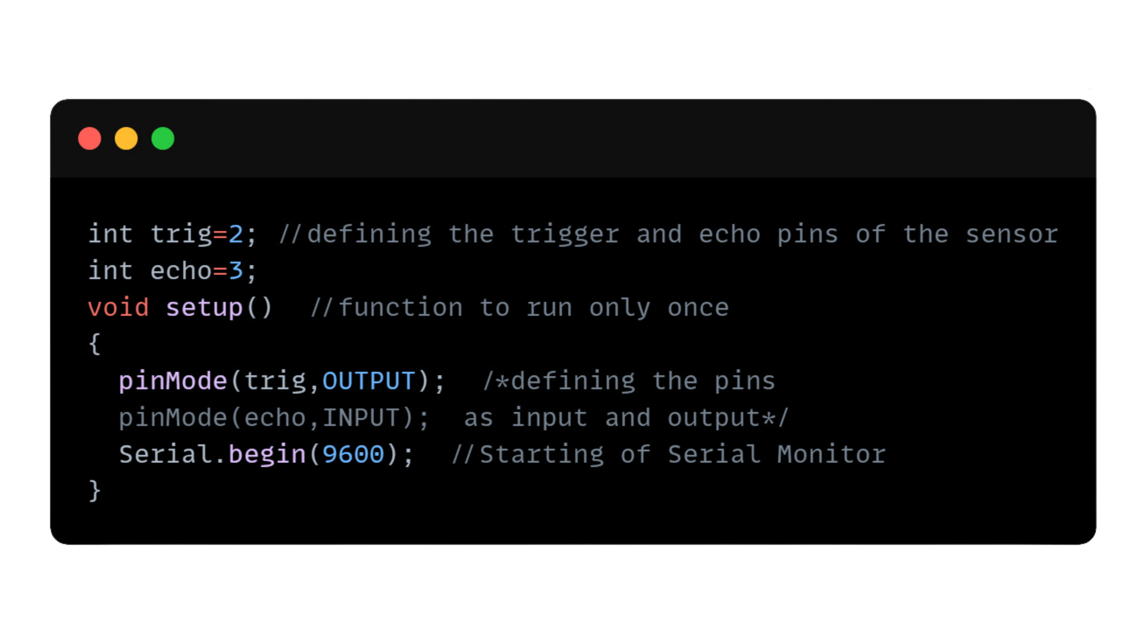
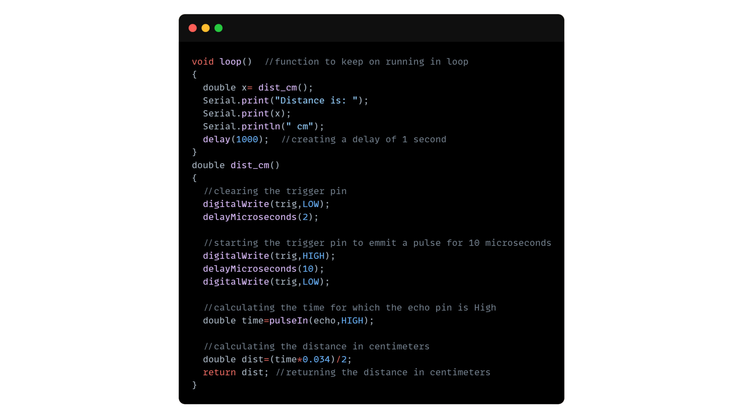
Working of Ultrasonic Sensor:
Setup:
Loop:

Slide 13
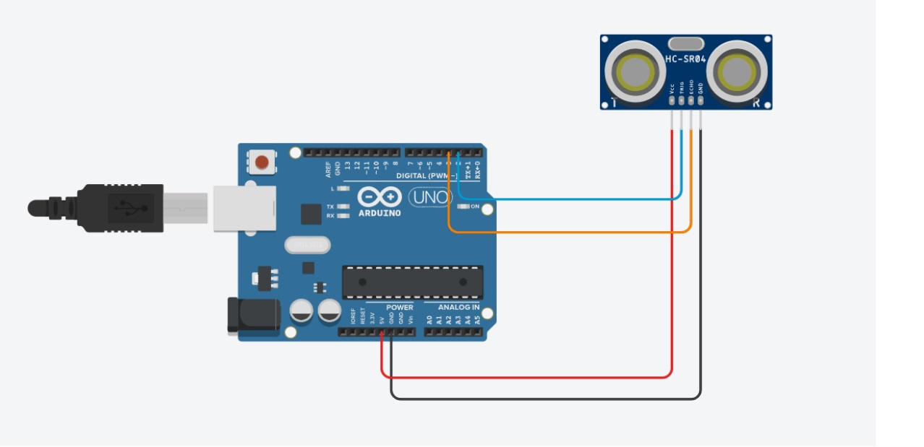
Circuit of Ultrasonic Sensor Interfacing:

Slide 14
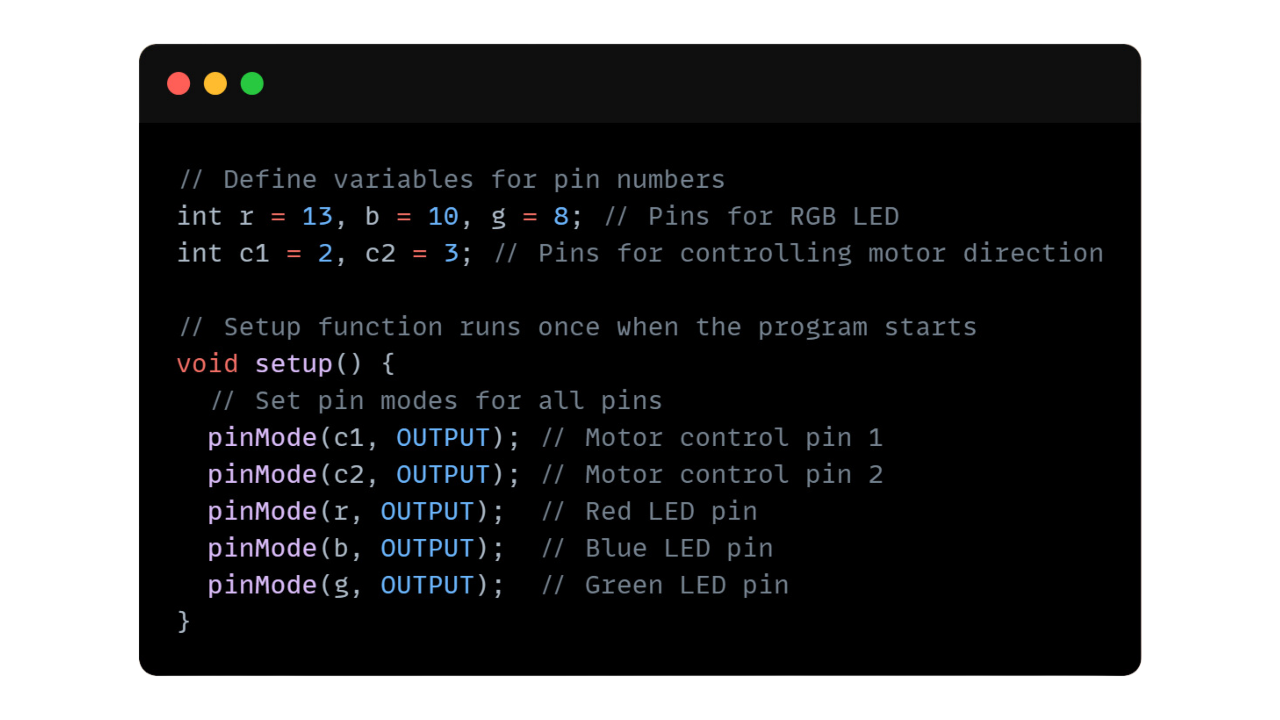
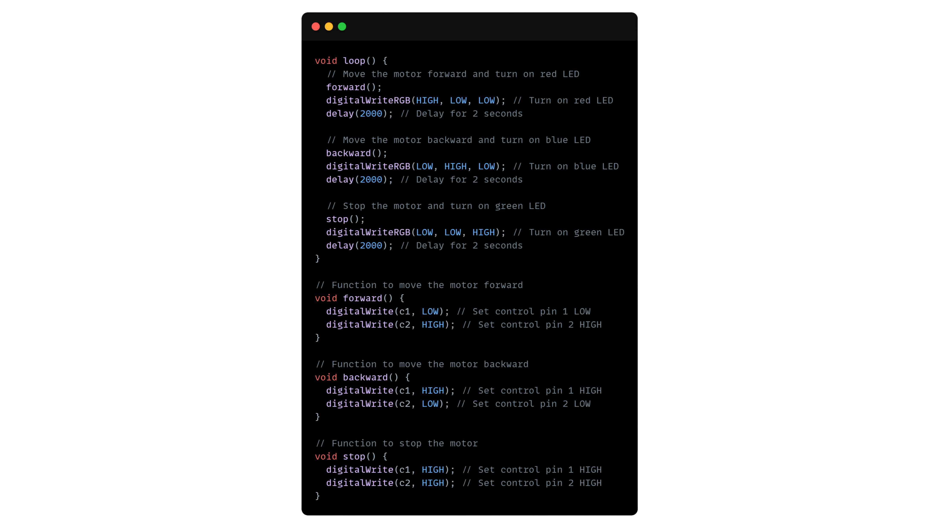
Working of DC Motor Using L293D:
Setup:
Loop:

Slide 15
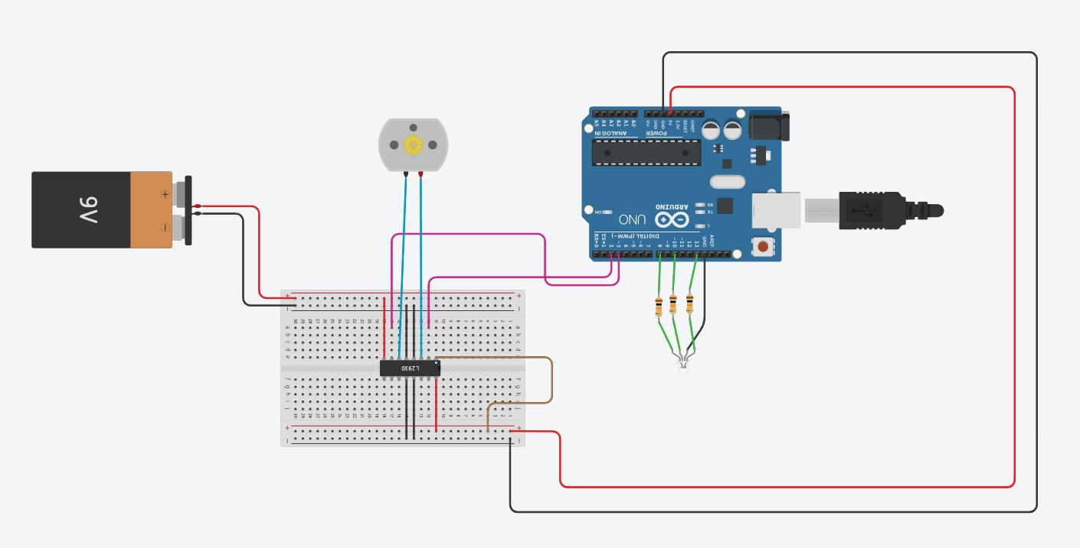
Circuit for DC Motor Interfacing Using L293D:

Slide 16
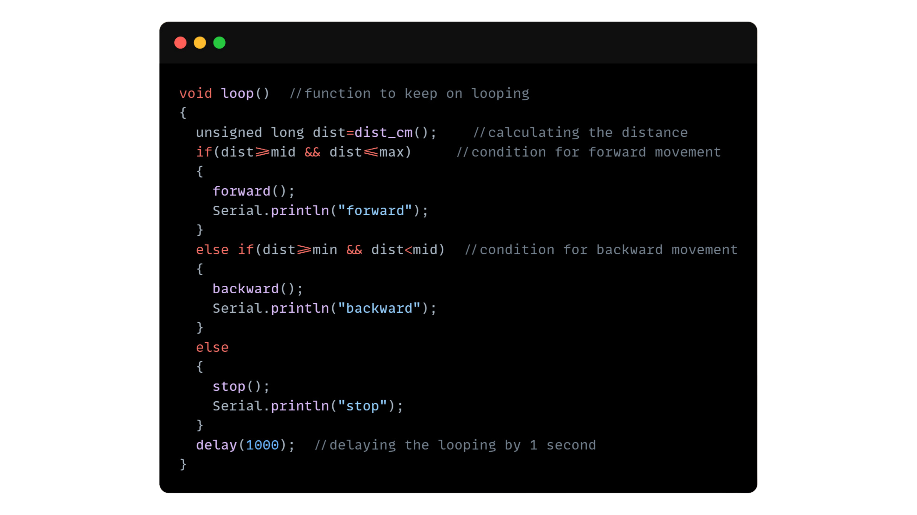
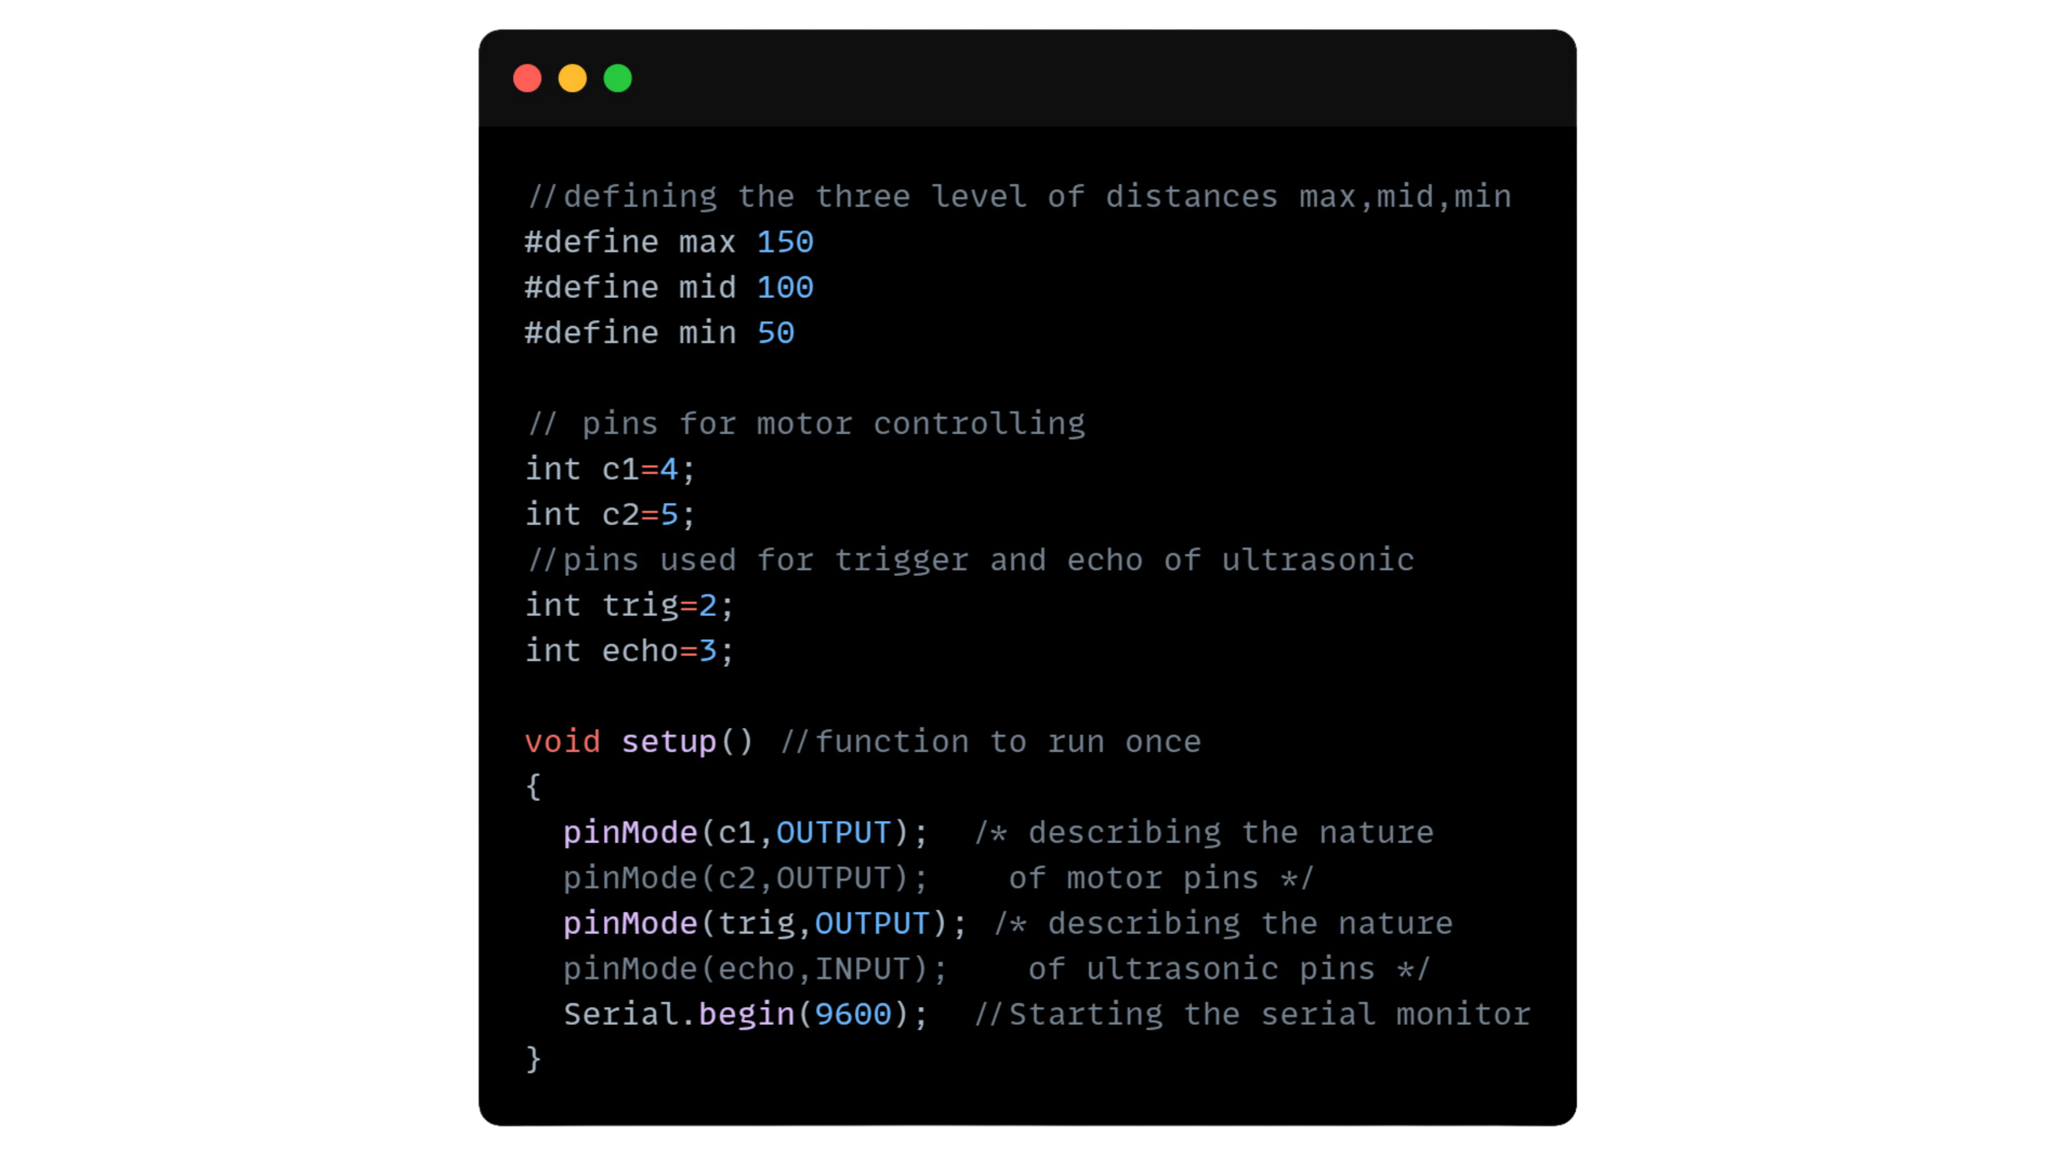
DC Motor Control Using Ultrasonic Sensor:
Setup:
Loop:

Slide 17
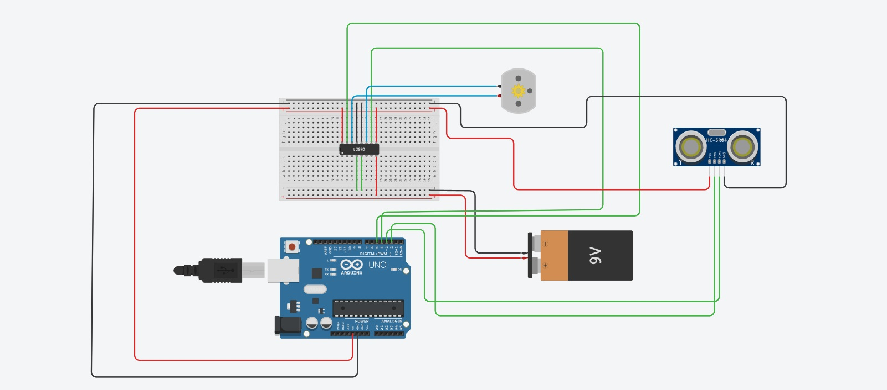
Circuit of DC Motor Control Using Ultrasonic Sensor:

Slide 18
Different Types of Maze Solving Algorithms:
Here are different types of maze-solving algorithms:
Depth-First Search (DFS)
Breadth-First Search (BFS)
Dijkstra's Algorithm
A* Algorithm
Greedy Best-First Search
Wall Follower (also known as Left-hand or Right-hand rule)
Trémaux's Algorithm
Recursive Division Algorithm
Prim's Algorithm (for maze generation, can be adapted for solving)
Kruskal's Algorithm (similarly, primarily used for maze generation)
Flood Fill Algorithm (especially for solving mazes with multiple paths)
Each of these algorithms has its own approach and suitability depending on the characteristics of the maze and the specific requirements of the problem.
We will be focusing on this(Left-hand)

Slide 19
Wall Follower Algorithm:
The Wall Follower Algorithm, also known as the "Left-hand rule" or "Right-hand rule" algorithm, is a simple maze-solving technique that operates based on the following principles:
Orientation: The algorithm requires the robot or solver to maintain a consistent orientation (either left-hand or right-hand) relative to the walls of the maze.
Rule: The solver follows a rule that dictates it should always keep its hand (left or right) touching a wall of the maze.
Movement: Depending on the orientation chosen (left-hand or right-hand), the solver makes decisions based on the following rules:
- If the chosen side (left or right) is clear, the solver continues moving in that direction.
- If the chosen side is blocked, the solver turns in the direction of the clear path, keeping the chosen hand touching the wall.
- If both sides are blocked, the solver may backtrack until it finds an open path.
Completion: The algorithm continues this process until the exit of the maze is found or until all accessible paths have been explored.
Performance: Wall Follower Algorithm guarantees finding the exit in a simply connected maze (a maze with no loops) that allows traversal of all its passages. However, it may fail to find the exit in more complex mazes with loops or disconnected regions.
Implementation: It's a straightforward algorithm to implement and can be executed by a robot or simulated programmatically. Additionally, it's commonly used as a benchmark for comparing the efficiency of more complex maze-solving algorithms.

Slide 20
Left-Hand Wall Follower Algorithm:
Consistent Left-Hand Orientation: The solver maintains a left-hand orientation relative to the maze walls throughout the exploration.
Movement Strategy: It follows a strategy where it continuously keeps its left hand touching the wall while navigating through the maze.
Prioritizing Left Turns: At intersections or junctions, the solver favors left turns whenever possible to ensure it remains following the left-hand rule.
Handling Obstacles: If the left-hand side becomes blocked, the solver turns right, ensuring it continues to keep its left hand touching the wall, thus avoiding obstacles.
Backtracking: When encountering dead ends or blocked passages, the solver retraces its steps by turning around until it can resume following the left-hand rule.
Effective in Certain Mazes: The Left-Hand Wall Follower Algorithm is effective in simply connected mazes without loops or disconnected regions where following a consistent rule ensures reaching the exit.
Simple Implementation: Due to its straightforward nature, the algorithm is easy to implement and is often used as a basic method for maze-solving tasks. However, its efficacy may diminish in more complex maze structures.

Slide 21
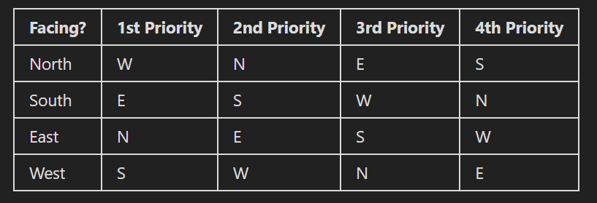
Left-Hand Wall Follower Algorithm Priority:

Slide 22
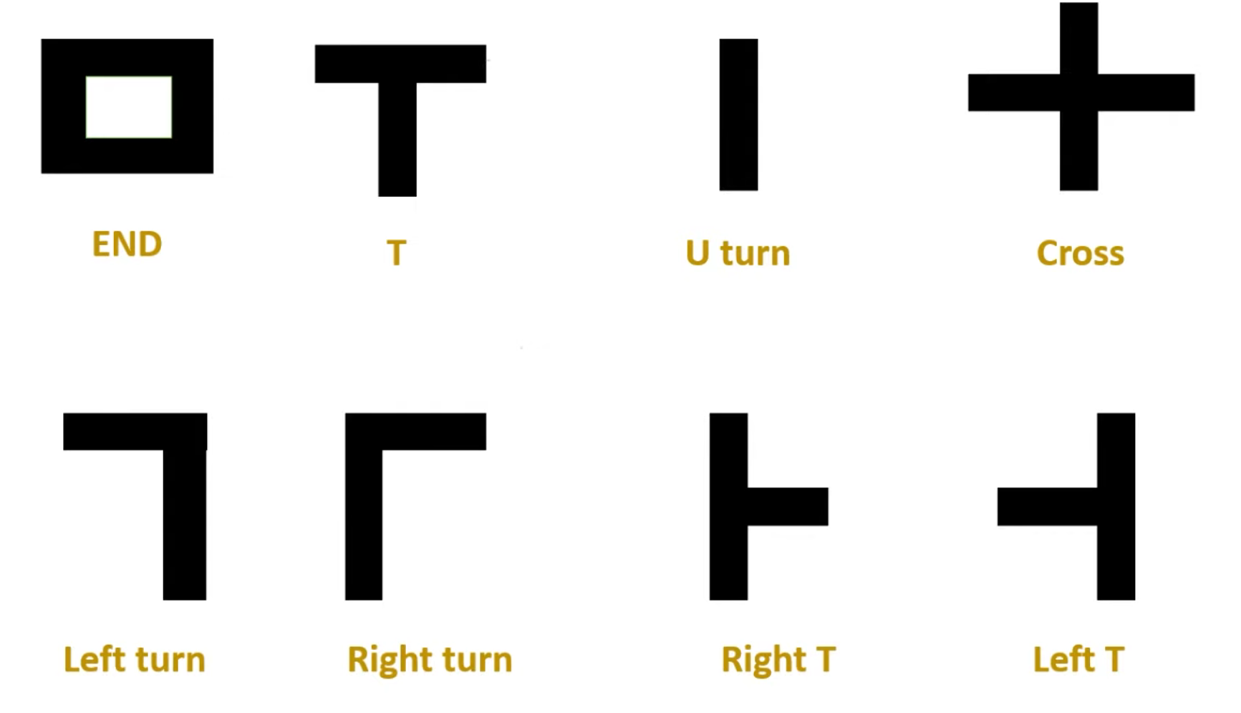
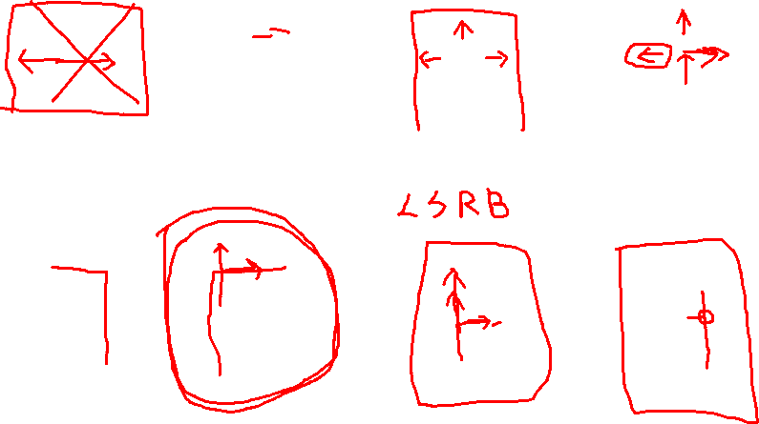
Possible Pathways:

Slide 23
Other Alternatives for solving:
Though we have discussed about the usage of Ultrasonic sensor based maze solver, we encourage our participants to use any of the maze solving algorithms, and we do support the use of different sensors like – camera, infrared etc.

Slide 24

GitHub Repository For Sample Codes:
GitHub link:
https://github.com/Krishanu-007/Techfiesta2k24_Entangled

